Slide 1
Efficient Hardware Implementation using SPICE Model for DRAM and LIF Neuron
Presenter: Subbaiah Ravi Hariprakash
m5282026
15/4/2025

Slide 2
Research Goal
Use SPICE model to implement DRAM
Change voltage and observe results
Check error rate and accuracy
Implement LIF neuron and observe changes

Slide 3
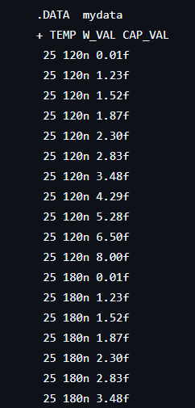
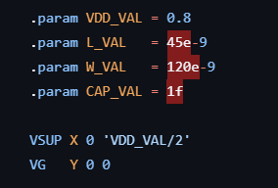
DRAM using HSPICE
Using HSPICE, a DRAM model can be designed and simulated
Input parameters are generated
With set parameters, simulation is done
Results are obtained

Slide 4
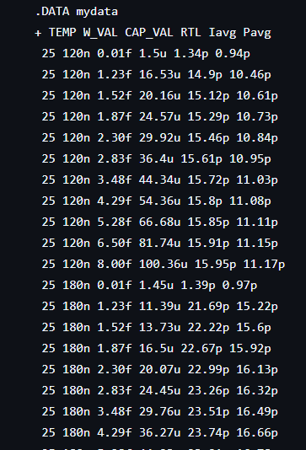
Parameters
Inputs include Temperature, Width, Capacitance, etc.
Results include average current and power
By changing input values, different results can be obtained.

Slide 5
LIF Neuron
The Leaky Integrate and Fire (LIF) Neuron mimics a biological neuron.
It integrates input signals and leaks energy over time.
When the stored energy passes a threshold, it fires a spike.
After the spike, it resets.

Slide 6
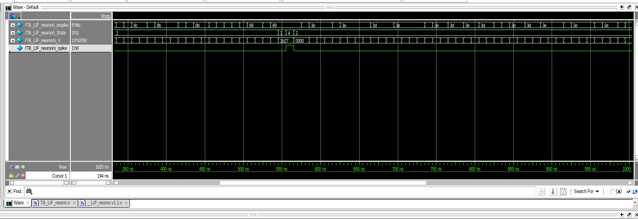
LIF Neuron - Working
Input spikes are being applied.
Once a certain point has been reached, the state changes.
The membrane potential increases until spike has been fired.
Once the spike fires it resets.

Slide 7
Research Progress On-going: eDRAM using HSPICE and LIF Neuron
Lowering voltage changes error rate
Error rate can be found by comparing obtained RTL and clock speed.
LIF neuron’s voltage must be changed to find its performance.

Slide 8
Schedule
Time Task | April 2025 | May 2025 | Jun 2025
Find error rate Run LIF neuron
Change parameters of LIF neuron
Find performance of LIF neuron and DRAM

Slide 9
References
[1] R. Kobayashi and K. N. Dang, "An Efficient Hardware Implementation of Spiking Neural Network Using Approximate Izhikevich Neuron," 2024 9th International Conference on Integrated Circuits, Design, and Verification (ICDV), Hanoi, Vietnam, 2024, pp. 13-18, doi: 10.1109/ICDV61346.2024.10616602.
[2] Ryoji Kobayashi, Ngo-Doanh Nguyen, Nguyen Anh Vu Doan and Khanh N. Dang, '’Energy-Efficient Spiking Neural Networks Using Approximate Neuron Circuits and 3D Stacking Memory’‘, 2024 IEEE 17th International Symposium on Embedded Multicore/Many-core Systems-on-Chip (MCSoC), Dec. 16-19, 2024.
[3] Du, Y. Decentralized Smart IoT. Encyclopedia. Available online: https://encyclopedia.pub/entry/8977 (accessed on 22 November 2022).
[4] S. H. Tsang, https://towardsdatascience.com/review-refinenet-multi-path-refinement- network-semantic-segmentation-5763d9da47c1
[5] John L. Hennessy, David A. Patterson, A New Golden Age for Computer Architecture, Communications of the ACM, February 2019, Vol. 62 No. 2, Pages 48-60, 10.1145/3282307

Slide 10
References
[6] A. Ben, K. N, Dang, Neuromorphic Computing Principles and Organization, Springer, 2022
[7] F. Akopyan et al., "TrueNorth: Design and Tool Flow of a 65 mW 1 Million Neuron Programmable Neurosynaptic Chip," in IEEE Transactions on Computer-Aided Design of Integrated Circuits and Systems, vol. 34, no. 10, pp. 1537-1557, Oct. 2015, doi: 10.1109/TCAD.2015.2474396.
[8] M. Davies et al., "Loihi: A Neuromorphic Manycore Processor with On-Chip Learning," in IEEE Micro, vol. 38, no. 1, pp. 82-99, January/February 2018, doi: 10.1109/MM.2018.112130359.
[9] B. V. Benjamin et al., "Neurogrid: A Mixed-Analog-Digital Multichip System for Large-Scale Neural Simulations," in Proceedings of the IEEE, vol. 102, no. 5, pp. 699-716, May 2014, doi: 10.1109/JPROC.2014.2313565.
[10] B. Vaidyanathan, W.-L. Hung, F. Wang, Y. Xie, V. Narayanan, and M. J. Irwin, “Architecting microprocessor components in 3d design space,” in 20th International Conference on VLSI Design, 2007. Held Jointly with 6th International Conference on Embedded Systems., pp. 103–108, IEEE, 2007.
[11] N. -D. Nguyen, A. B. Ahmed, A. B. Abdallah and K. N. Dang, "Power-Aware Neuromorphic Architecture With Partial Voltage Scaling 3-D Stacking Synaptic Memory," in IEEE Transactions on Very Large Scale Integration (VLSI) Systems, vol. 31, no. 12, pp. 2016-2029, Dec. 2023, doi: 10.1109/TVLSI.2023.3318231

Slide 11
Thank You

